Slide 1
Theory of Computation
Lecture 3
Finite State Automata (FSA)

Slide 2
Syllabus and Terminologies
Regular Languages .. Regular Sets
REs (Regular Expressions)
FSMs (or FSA/FA) … Finite State Machines/Automata
DFA vs. NFA … Deterministic vs. Non-deterministic FSA
Comparison and conversion
Examples & Closure Operations
Pumping Lemma
Context Free Languages
CFGs … Context Free Grammars
PDA … Push Down Automata
Parsing: CFG generating strings vs. PDA recognizing strings
Turing Machine

Slide 3
Three Views
Three equivalent formal ways to approach Regular Languages
Specification
Regular Expressions
Regular
Languages
Finite State Automata
Regular Grammars
Implementation
Representation

Slide 4
Regular Language to a Program
Using Regular Language to generate a program that accepts this language!
NFA
Regular
expressions
DFA
Regular
languages
Implementation of DFA
as a Program

Slide 5
What is Automata ?
5

Slide 6
What is Automata ?
Automata is the plural of Automaton.
Automaton is an abstract machine that represents a digital computer with some capabilities
Thus, the simulation of running an automaton (over some input) to solve a problem gives a clue about the capabilities needed to solve this problem using a real computer.

Slide 7
Types of automata
Automata can be either:
Deterministic automata:
Each move is uniquely determined by the current configuration; if we know the internal state, the input, and the contents of the temporary storage, we can predict the future behavior of the automaton exactly.
Nondeterministic automata:
At each point, a nondeterministic automaton may have several possible moves, so we can only predict a set of possible actions.

Slide 8
Types of automata
Also, Automata can be either:
Accepter: an automaton whose response is limited to a simple “yes” or “No”. Presented with input string, an accepter either accepts or rejects it.
Transducers: a more general automaton that capable of producing strings of symbols as output.

Slide 9
Finite Automata (FA) = Finite State Automata (FSA) = Finite State Machines (FSM)
9

Slide 10
Finite Automaton
Input
String
Output
“Accept”
or
“Reject”
Finite
Automaton

Slide 11
Why “finite”?
FA have finite number of states.
FA have limited memory.
It can’t remember the processed symbols of the input string.

Slide 12
Representation of FA
FSA can be represented either by:
State Transition Diagram/Graph
State Transition Table

Slide 13
Finite Automata State Graphs
A state
The start state
An accepting/final state
a
A transition

Slide 14
A Simple Example
A finite automaton that accepts only “1”
A finite automaton accepts a string if we can follow transitions labeled with the characters in the string from the start to some accepting state
1

Slide 15
Another Simple Example
A finite automaton accepting any number of 1’s followed by a single 0
Alphabet: {0,1}
Check that “1110” is accepted but “0110” is not
What is the RE corresponding to this FA?
1
0

Slide 16
Simple notations
a
a*
a+
(a+b)*
start
0
a
1
a
start
0
a
start
0
a
1
a
start
a, b
0
start
0
b

Slide 17
Another Example
Example transition diagram to recognize (a+b)*abb
a
a
q1
b
q2
b
q0
q3
b

Slide 18
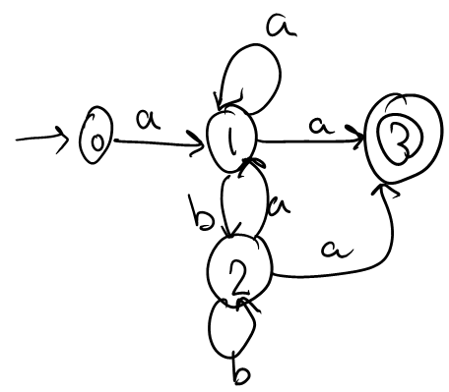
Practice
Draw the transition diagram for recognizing the following regular expression. (3 possible answers!)
a(a+b)*a
b
a
a,b
1
a
2
a
3
1
a
2
a
3
b

Slide 19



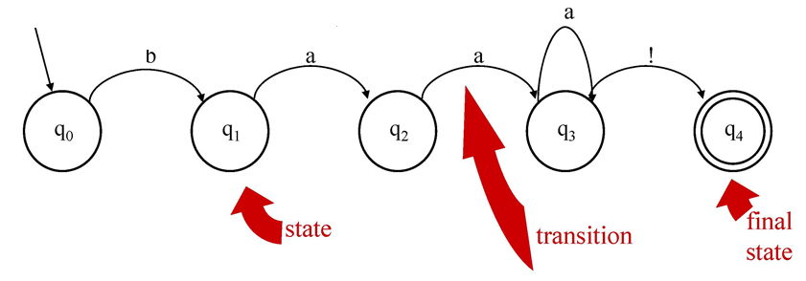
Finite automata
baaa*!

Slide 20
FA as a Transition Diagram
FA can be represented using transition diagrams.
A transition diagram has:
States represented by circles;
An Alphabet (Σ) represented by labels on edges;
Transitions represented by labeled directed edges between states. The label is the input symbol;
One Start State shown as having an arrow head;
One or more Final State(s) represented by double circles.

Slide 21
Finite-State Automata
Definition: A finite-state automaton is a 5-tuple M=(S, I, f, S₀, F) where
S is a finite set of states
I is a finite input alphabet
f:(S_{i}xI)→S_{j} is a transition function from a (state x input) pair to another destination state
S₀ is the initial state
F⊆S is a set of final states

Slide 22
Example
FSA is a 5-tuple (Q, Σ, δ, q0, F) consisting of
Q: set of states {q0,q1,q2,q3,q4}
Σ: an alphabet of symbols {a,b,!}
δ(q,i): a transition function mapping Q x Σ to Q
q0: a start state in Q
F: a set of final states in Q {q4}
a
b
a
a
!
q0
q1
q2
q3
q4

Slide 23
Finite automata
An FSA recognizes (accepts) strings of a regular language
baa!
baaa!
baaaa!
…
Input Tape: will this input be accepted?
 | b | a | A | a

Slide 24
Another View: A State Transition Table for SheepTalk
Remember that there are 2 ways to represent a FSM:
State Transition Diagram
State Transition Table
State | Input
 | b | a | !
0 | 1 | - | -
1 | - | 2 | -
2 | - | 3 | -
3 | - | 3 | 4
4 | - | - | -
a
b
a
a
!
q0
q1
q2
q3
q4

Slide 25
FSA Recognition
Possible Goals
Determine whether a string should be accepted by a machine
Or… determine whether a string is in the language defined by the automaton
Or… determine whether a regular expression matches a string

Slide 26
Input Tape
q₀
REJECT
a
b
a
!
b
b
a
a
a
!
0
1
2
3
4
Slide from Dorr/Monz
Notes:
26

Slide 27
Input Tape
q₀
q₁
q₂
q₃
q₃
q₄
ACCEPT
b
a
a
a
!
b
a
a
a
!
0
1
2
3
4
Slide from Dorr/Monz

Slide 28
Another Example
Alphabet {0,1}
What language does this machine recognize?
1
0
0
0
1
1

Slide 29
And Another Example
Alphabet still { 0, 1 }
The operation of the automaton is not completely defined by the input
On input “11” the automaton could be in either state
1
1

Slide 30
Language Recognition
Definition: A finite-state automaton accepts (or recognizes) a string x if f(S₀, x)∈F. That is, the finite state automaton ends up in a final state.
Definition: The language accepted (or recognized) by a finite-state automaton M, denoted by L(M), is the set of all strings recognized by M.
Definition: Two finite-state automata are equivalent if they recognize the same language.

Slide 31
How FA can take decision?
It ACCEPTS the input string if:
If end of input, and an acceptance state is reached
It REJECTS the input string if:
If no transition to a final state is possible (got stuck)
If tape still has input, even if a final state is reached

Slide 32
Transition Graph
initial
state
accepting
state
transition
state

Slide 33
Initial Configuration
Input String

Slide 34
Reading the Input

Slide 38
Input finished
accept

Slide 39
Rejection

Slide 43
Input finished
reject

Slide 44
Another Rejection

Slide 45
reject

Slide 46
Part 2

Slide 47
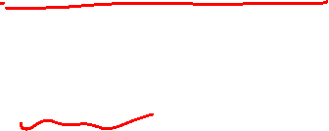
Another Example

Slide 48


Slide 49


Slide 51
Input finished
accept

Slide 52

Rejection Example

Slide 54


Slide 56
Input finished
reject

Slide 57
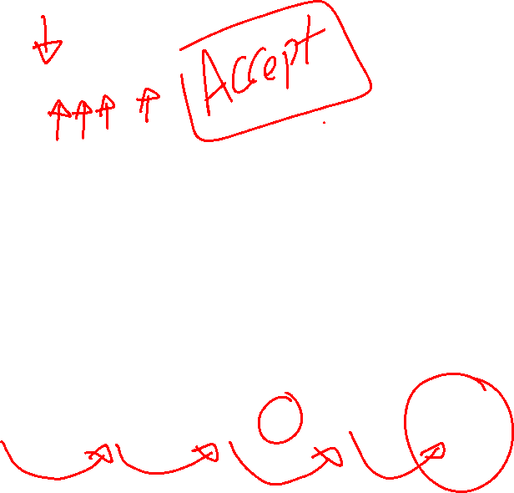
More Examples …
accept

Slide 58

More Examples …
accept
accept
accept

Slide 59
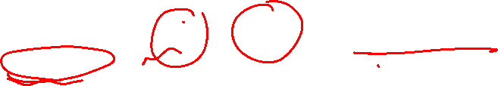
Finite Automata
A finite automaton is a recognizer that takes a string, and answers “yes” if the string matches a pattern of a specified language, and “no” otherwise.
Two kinds:
Nondeterministic finite automaton (NFA)
no restriction on the labels of their edges
Deterministic finite automaton (DFA)
exactly one edge with a distinguished symbol goes out of each state
Both NFA and DFA have the same capability
We may use NFA or DFA as lexical analyzer of a compiler

Slide 60

Finally
We have
Languages
accepted
by NFAs
Languages
accepted
by DFAs

Slide 61

Epsilon Moves in NFA!
Another kind of transition: ε-moves
ε
A
B
Machine can move from state A to state B without reading input

Slide 62

Deterministic and Nondeterministic Automata
Deterministic Finite Automata (DFA)
One transition per input per state
No ε-moves
Nondeterministic Finite Automata (NFA)
Can have multiple transitions for one input in a given state
Can have ε-moves

Slide 63

Difference in the formal definition
Definition: A finite-state automaton is a 5-tuple M=(S, I, f, S₀, F) where
S is a finite set of states
I is a finite input alphabet
f:(S_{i}xI)→S_{j} is a transition function from a (state x input) pair to another destination state
S₀ is the initial state
F⊆S is a set of final states
DFA: exactly one transition for each distinct (state X symbol) pair
NFA: no restriction:
A state can have no transition for an input symbol
A state can have one ore more transition(s) for an input symbol
A state can have ε-move transition

Slide 64

Deterministic Finite Automata (DFA)
Example:
b
a
1
a
0
3
a, b
a
b
b
2
The above automaton accepts the strings aba, baaabab. However it rejects any string of the form ab^{n}.

Slide 65
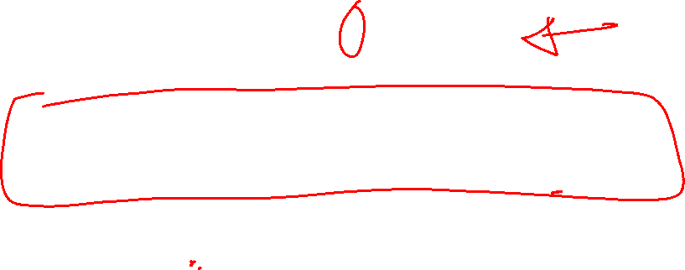
DFA
Example
M =({q0, q1, q2}, {0,1}, δ, q0, {q1}),
where δ is
δ(q0, 0) = q0 δ(q0, 1) = q1 δ(q1, 0) = q0
δ(q1, 1) = q2 δ(q2, 0) = q2 δ(q2, 1) = q1
0
0
1
0
q0
q1
q2
1
1

Slide 66

The non-Deterministic Finite Automata (NFA)
A nondeterministic finite automaton is defined as quintuple M = (Q, Σ, δ, q₀, F), where Q, Σ, q₀, F are defined as for dfa but δ : Q X (Σ ∪ λ) → 2^{Q} and δ is a relation.
There are three major differences between dfa and nfa:
The range of δ is in the power set 2^{Q}, so that its value defines a set of all possible states that can be reach by the transition
We allow λ as the second argument, this means that nfa can make a transition without consuming any input symbol
The value of δ may be empty, meaning that there is no transition defined for this specific situation.

Slide 67
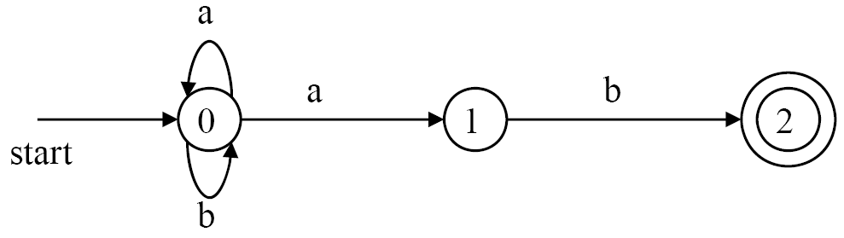
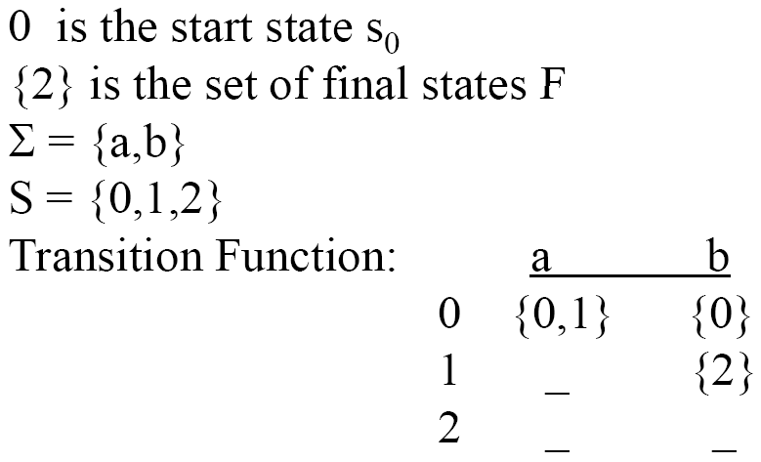

NFA Example (1)
The language recognized by this NFA is ?? (a+b)* ab
Notes:
This NFA recognizes all strings of a's and b's ending in the ab.
The double circle around state 2 indicates that this state is accepting. Notice that the only ways to get from the start state 0 to the accepting state is to follow some path that stays in state 0 for a while, then goes to states 1 and 2 by reading ab from the input. Thus, the only strings getting to the accepting state are those that end in ab.

Slide 68
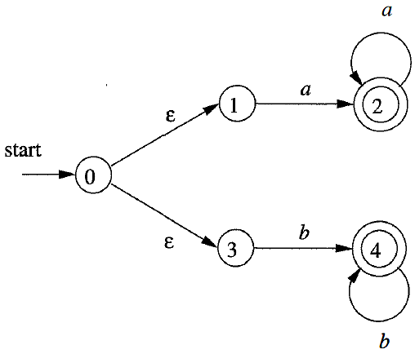
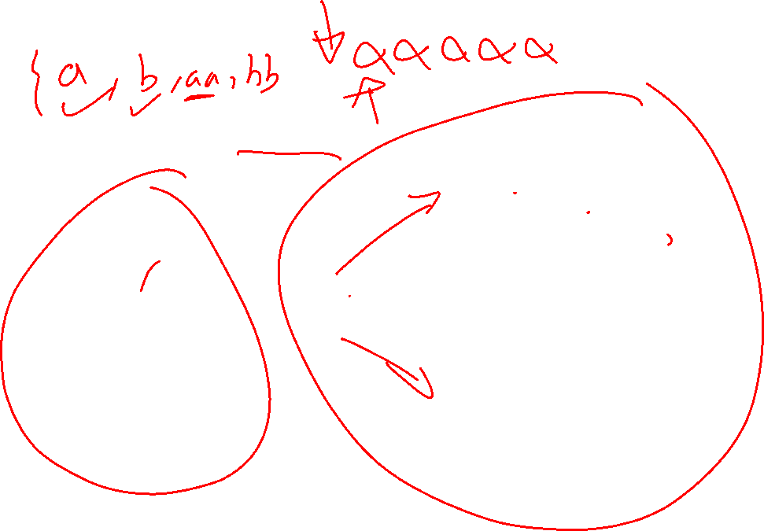
NFA Example (2)
NFA accepting aa* + bb*

Slide 69
Regular Expressions to Finite Automata
High-level sketch
NFA
Regular
expressions
DFA
Lexical
Specification
Table-driven
Implementation of DFA

Slide 70
Regular Expression and FA
Every language that can be defined by a regular expression can also be defined by a finite automaton.
So we will see how to convert Regular expression to a FA, then how to convert FA to Regular expression.

Slide 71
RE and Finite State Automaton (FA)
Regular expression is a declarative way to describe the tokens
It describes what is a token, but not how to recognize the token.
FA is used to describe how the token is recognized
FA is easy to be simulated by computer programs;
There is a 1-1 correspondence between FA and regular expression
Scanner generator (such as lex) bridges the gap between regular expression and FA.
String stream
Finite automaton
scanner program
Regular expression
Scanner generator
Tokens

Slide 72
Inside scanner generator
Main components of scanner generation (e.g., Lex)
Convert a regular expression to a non-deterministic finite automaton (NFA)
Convert the NFA to a determinstic finite automaton (DFA)
Improve the DFA to minimize the number of states
Generate a program in C or some other language to “simulate” the DFA
RE
NFA
Subset construction
DFA
Minimization
Minimized DFA
DFA simulation
Scanner generator
Program

Slide 73
NFA
73

Slide 74
Non-deterministic Finite Automata (FA)
NFA (Non-deterministic Finite Automaton) is a 5-tuple (S, Σ, δ, S0, F):
S: a set of states;
Σ: the symbols of the input alphabet;
δ : a set of transition functions;
move(state, symbol) → a set of states
S0: s0 ∈S, the start state;
F: F ⊆ S, a set of final or accepting states.
Non-deterministic -- a state and symbol pair can be mapped to a set of states.
Finite—the number of states is finite.

Slide 75
Nondeterministic Finite Automaton (NFA)
NFA can be represented by a transition graph
Accepts a string x, if and only if there is a path from the starting state to one of accepting states such that edge labels along this path spell out x.
Remarks
The same symbol can label edges from one state to several different states
An edge may be labeled by ε, the empty string
Notes:
过渡：We now look into each of the automaton.
NFA can be represented by a transition graph, where the nodes are states and the labeled edges represent the transition function.
Remark 2: In other words, we can move from one state to another one without consuming any symbol.
补充：An NFA accepts a string x, if and only if there is a path from the starting state to one of accepting states such that edge labels along this path spell out x.

Slide 76
Regular Expressions to NFA (1)
For each kind of rexp, define an NFA
Notation: NFA for rexp A
A
For ε
ε
For input a
a

Slide 77
Regular Expressions to NFA (2)
For AB
ε
A
B
For A | B
B
ε
ε
ε
ε
A

Slide 78
Regular Expressions to NFA (2)
RE = abc

Slide 80
Regular Expressions to NFA (3)
For A*
ε
A
ε
ε

Slide 81
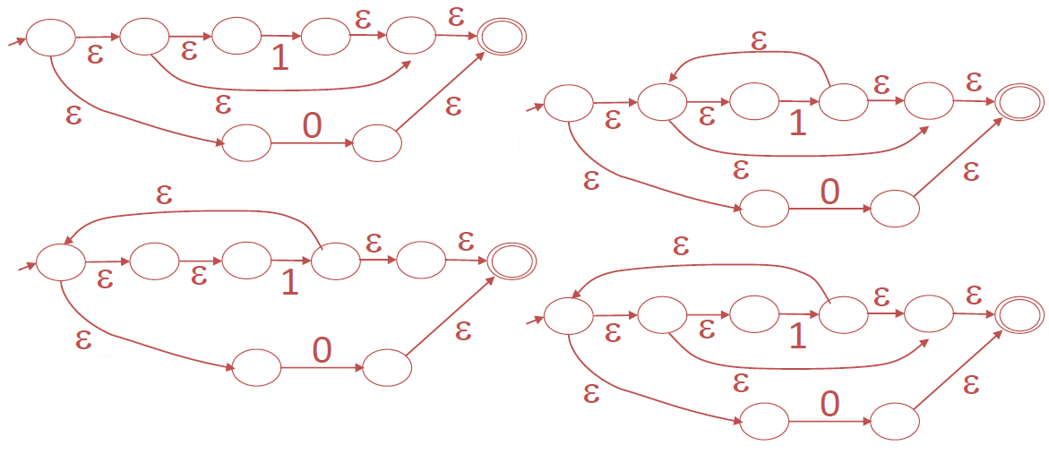
Example of (RE → NFA) conversion
Choose the NFA that accepts the following regular expression: 1* + 0

Slide 82
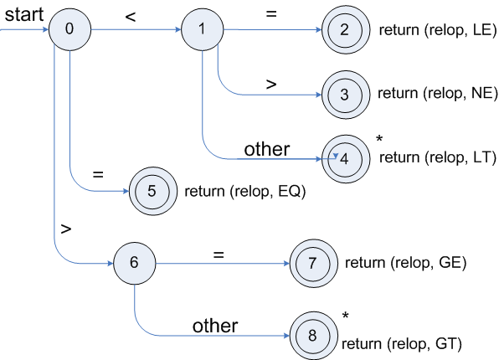
Transition diagrams
Transition Diagram for "relop → < | > |<= | >= | = | <>"

Slide 83
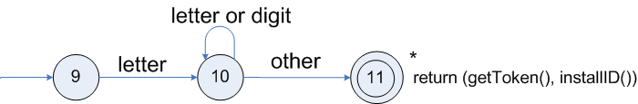
Transition diagrams
A transition diagram for valid identifiers

